Slide 1
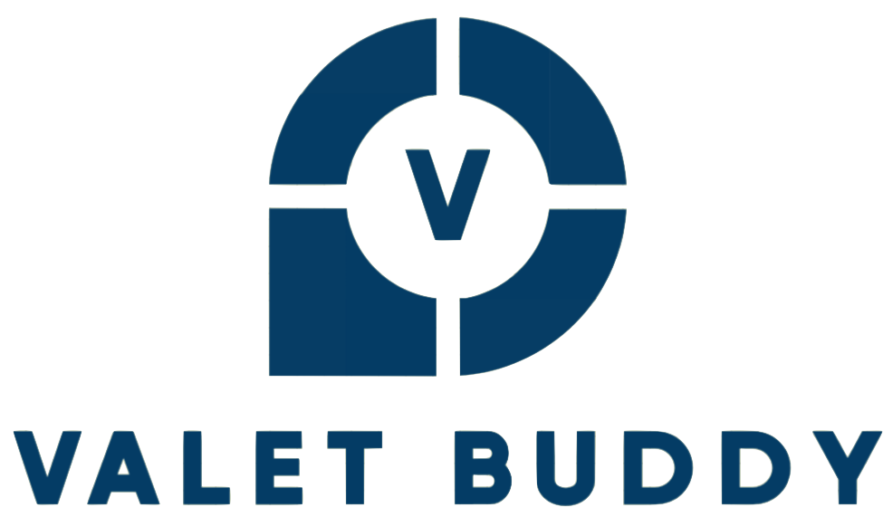
Airport Valet Car Locator Mobile App
Jordan Treutel, Richard Hoehn, Ian Hurd, Patrick Burnett
November 6th, 2023

Slide 2
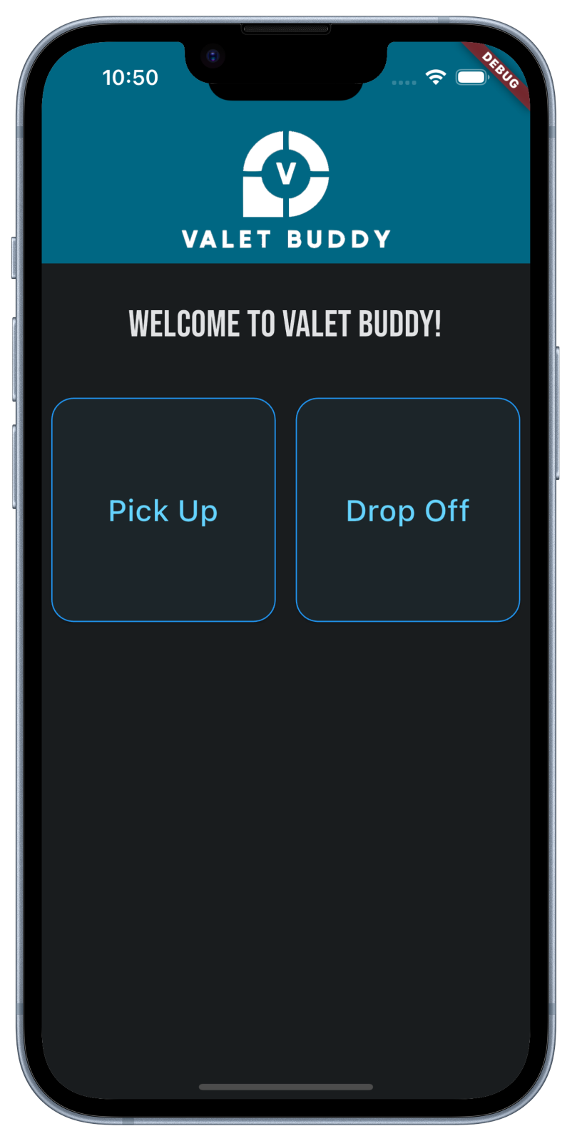



Introduction
RH
Mobile App for Valet Parking at Airports
App is solely used by the Valets
Business Case of App is Simple
GPS Location Tagging instead of parking field numbers
Scalable Parking Lots
No cost for painting numbers
Client / Server Architecture
Server – Python Flask Server with TinyDB as the datastore
Client – Flutter - iOS & Android Cross Platform Development

Slide 3
Requirements Gathering – Stakeholders/Users
RH
Airport administration
Valets (drivers) - main users of the app
Airport travelers (car owners)
Owner of airport parking lot
Business and financial staff at Valet Buddy company

Slide 4
Requirements Gathering Functional Requirements
JT
Users can input the car's license plate number
Users can upload a picture of their car to the app
User can save GPS coordinates of a car's location
Users can access a list of cars and select one to retrieve its coordinates
Users can only see cars from their own airport, unless they are an airport administrator
Valet drivers can report problems with cars, such as cars being damaged or stolen
Each car is given a "ticket" which tracks all data about its drop-off and pick-up
There exists a list of tickets, each entry storing a picture of the car, the car's license plate number, the name of the car's owner, and the coordinates of the car's location

Slide 5
Requirements Gathering – Non Functional Requirement
JT
In Scope
Out of Scope
JSON for data transfer
Flutter - mobile framework
Dart – mobile programming language
Google Maps API
Python
Flask (REST)
Database – TinyDB (native python)
All communications done via 'https'
Backing up database and car images to AWS S3 on a daily basis
For demo, will store files on server – Usually this would be in AWS S3
Monetization
Email Weekly map (PDF) of all location of the cars

Slide 6
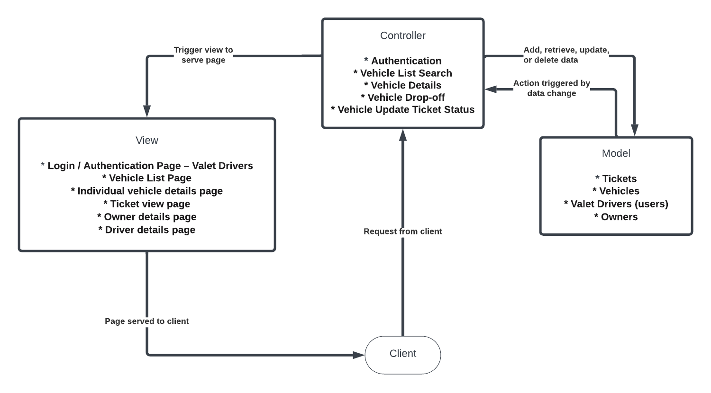
Design Architecture - MVC
PB

Slide 7
Key Object-Oriented Principles
IH
Inheritance (Flutter)
Widget inheritance is one of the design patterns in Flutter.
Most all UI frameworks (flutter, angular, react) use inheritance to manage the UI state.
Composition
In Flutter we regularly use composition, in that a widget (Expl: Container) is passed a "child" widget of type TextBox() - This means that the Container is composable.
Encapsulation
Our Valet Buddy app is heavily reliant on encapsulation. This can be observed by our class diagram implementing methods that only that class can perform.
This is important since it places restrictions on accessing methods directly and prevents accidental modification of data and states of the Tickets.

Slide 8
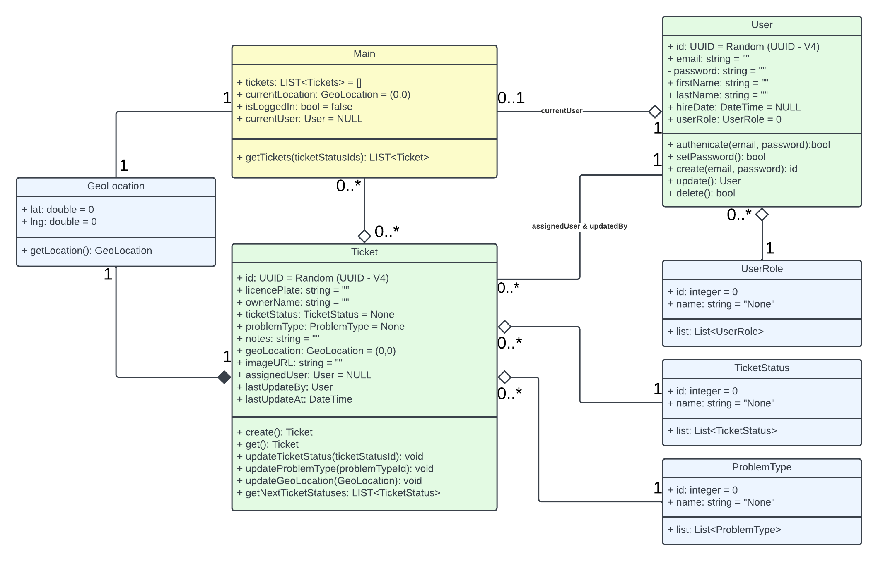
Class Diagram
PB

Slide 9
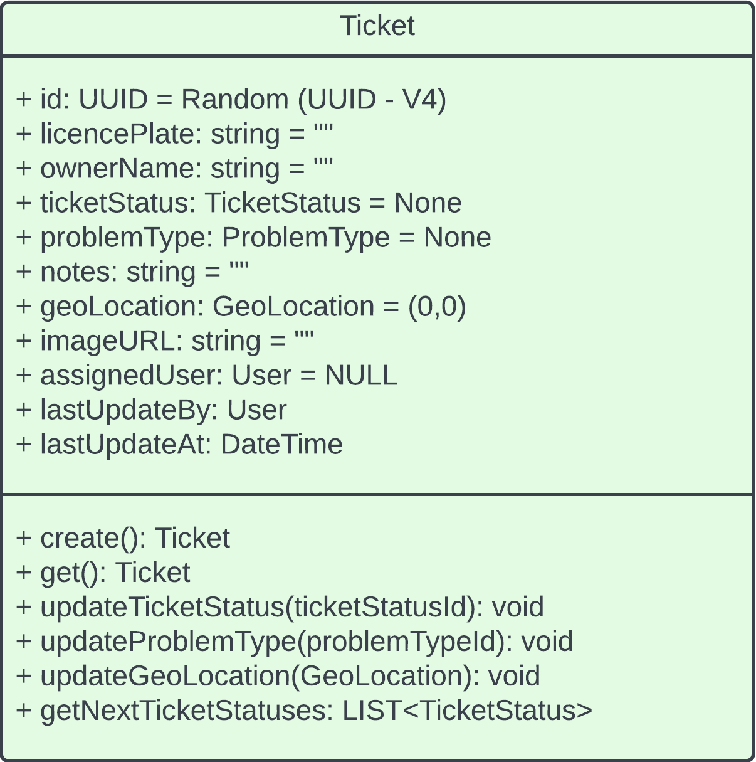
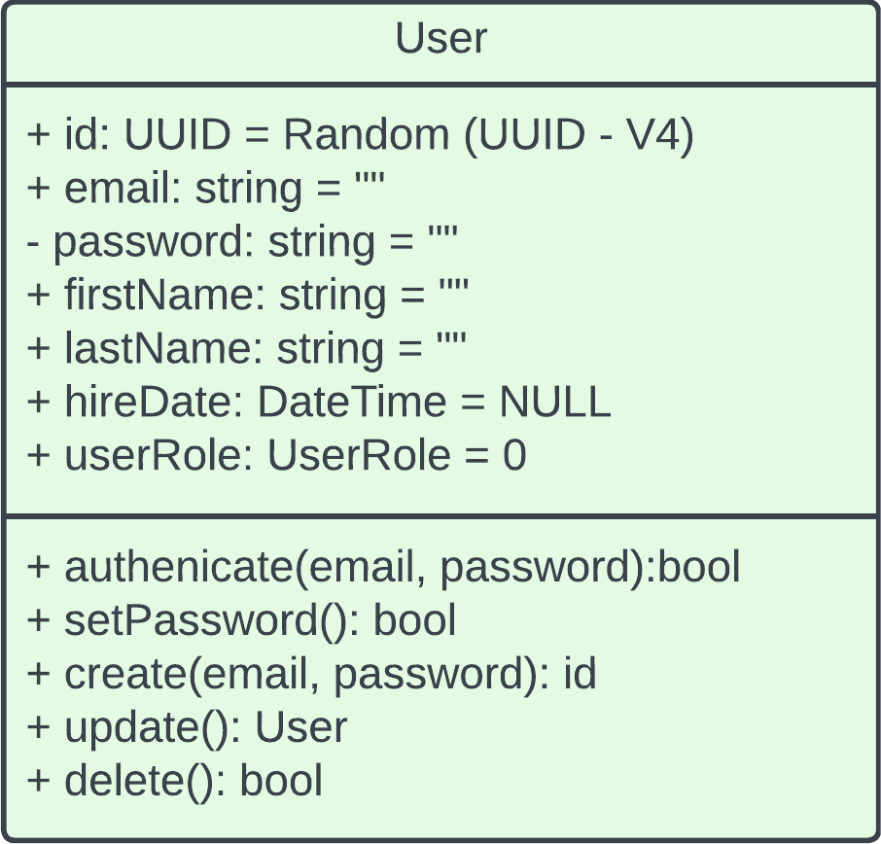
Class Diagram – Ticket & User
PB

Slide 10
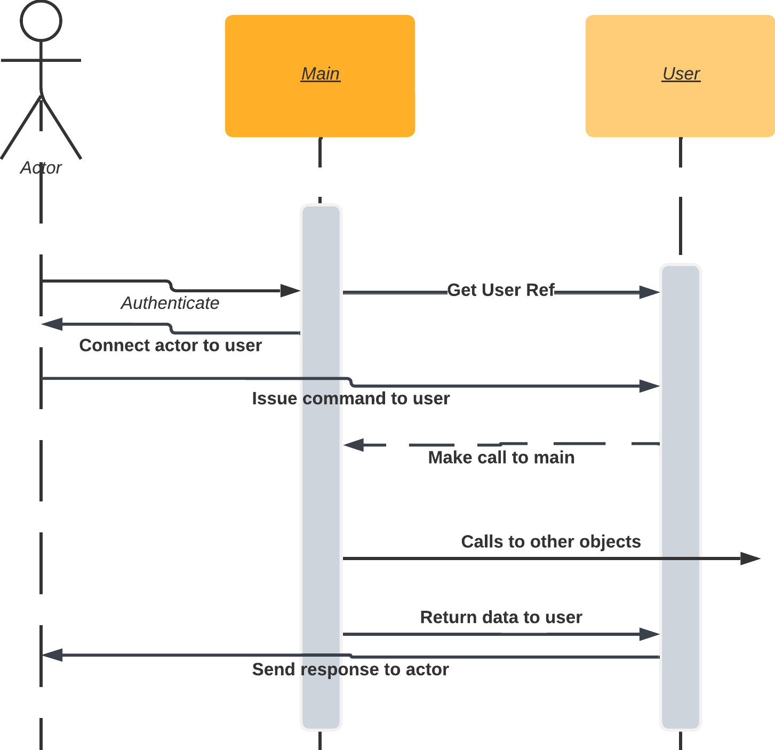
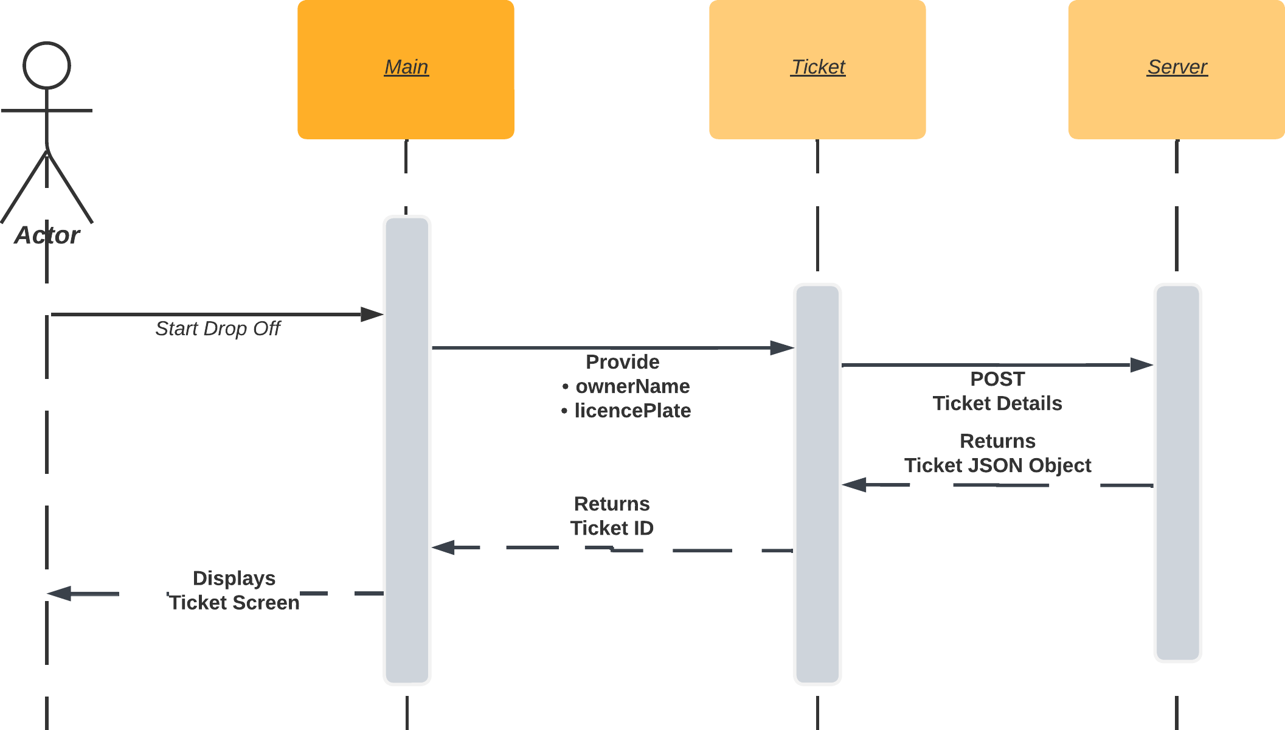
Sequence Diagram – Auth & Ticket
IH & RH

Slide 11
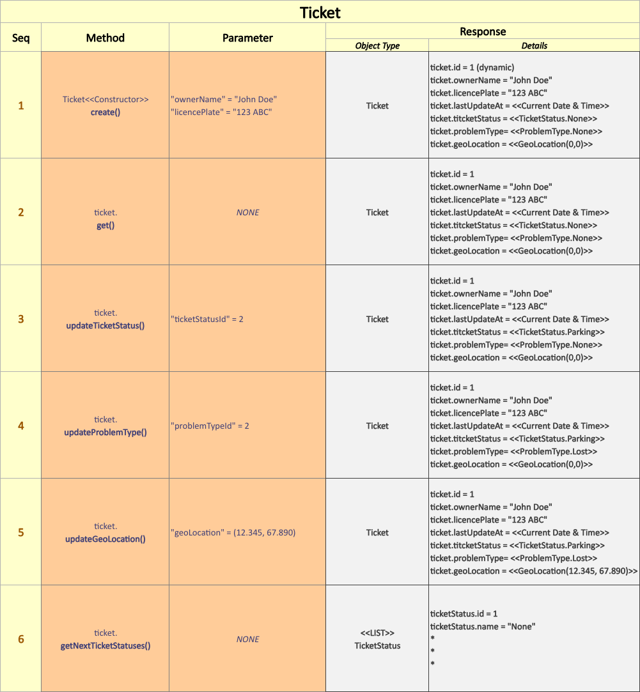
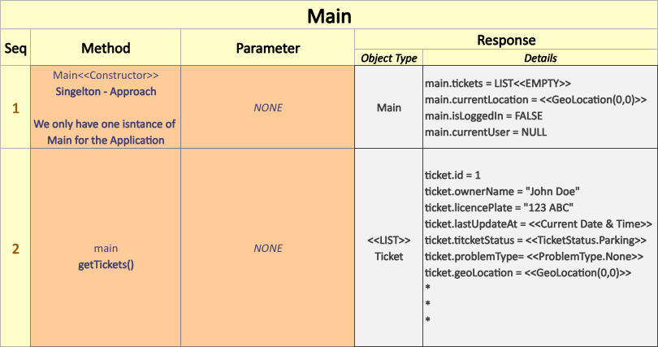
Unit Testing
RH
Valet Buddy Unit Test Strategy
Test Early & Often
Prioritize the Critical Path
Implement Using Flutter's Test Package Runners

Slide 12
OO Principles & Modular Code
IH
Code Reusability
Maintainability (changing one part of code doesn't mess with unrelated functionality)
Config file for changing global values across the app (IP, port, host name, color themes, and other constants)
Readability (organized and easy to compartmentalize in your head)

Slide 13
Summary
RH
Valet Buddy is a mobile app that helps valet drivers record parking of vehicles and eliminates need to maintain physical numbering of parking spaces by GPS location tagging.
Client / Server Architecture
Server – Python Flask Server with TinyDB as the datastore
Client – Flutter - iOS & Android Cross Platform Development
Object-Oriented design (Python & Flutter)
Heavy use of Inheritance (essence of cross platform development)
Unit Testing via Flutter Test Package Runners

Slide 14
Key Takeaways
JT
Adding or modifying any project or feature can grow in complexity very quickly
Expl: Ticket Status + Problem Types etc...
Design Architecture of choice = foundation for development
Class Diagrams = transition from design to implementation
Lots of time spent on defining the methods
Challenges:
Fitting Design Architecture to MVC
Do model and view directly communicate?
Valet drivers send requests directly to controller, not the view
Deciding relationships between classes
Mobile App vs. Server might require two different Architectures

Slide 15
Questions?

